Slide 1
Classification

Slide 2
Learning
Learning by Recording Cases
Incremental Concept Learning
Classification
Version Spaces

Slide 3
Lesson Preview
Learning concepts
Equivalence classes
Concept hierarchies
Types of concepts
Bottom-up search

Slide 4
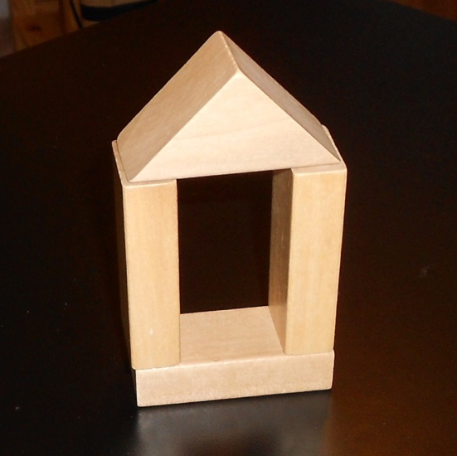
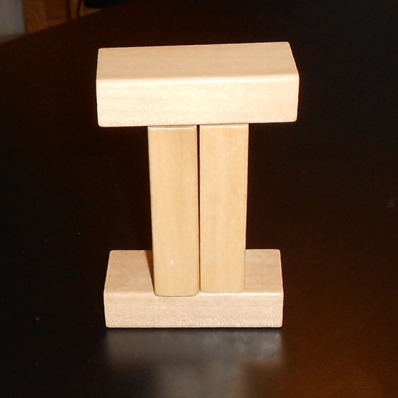
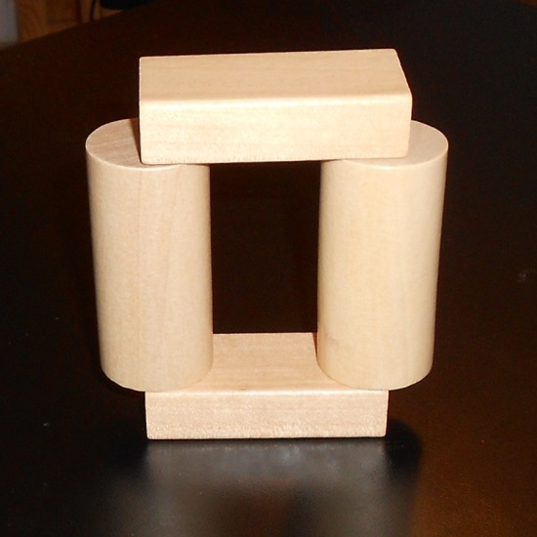
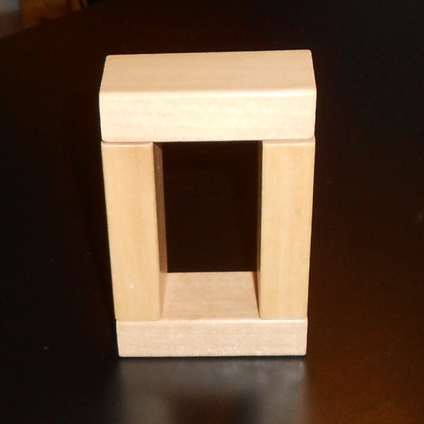

Slide 5
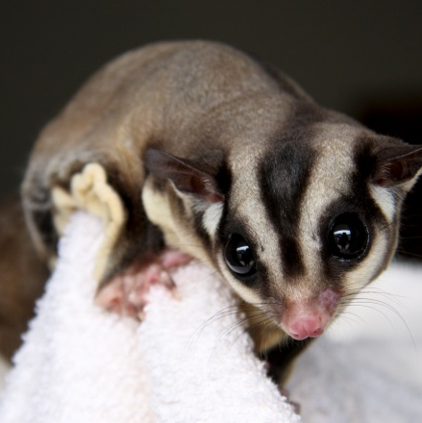
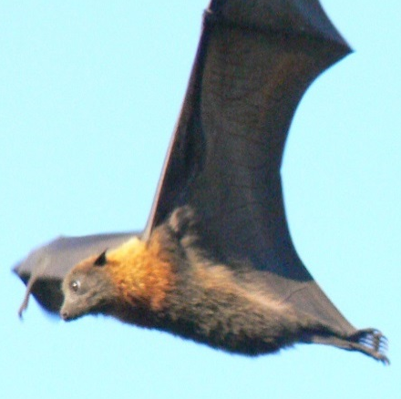
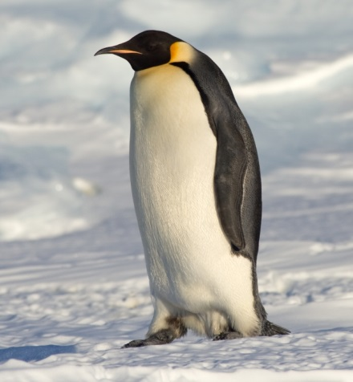
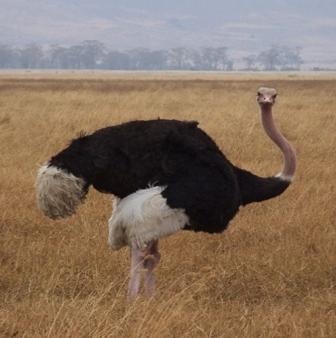
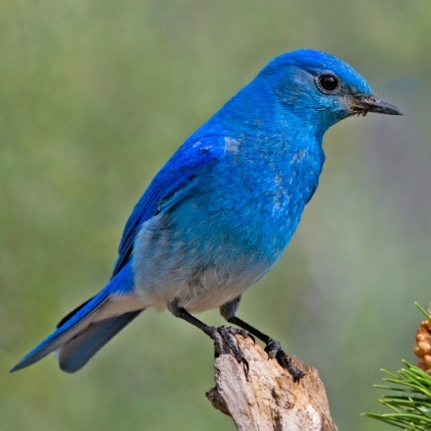
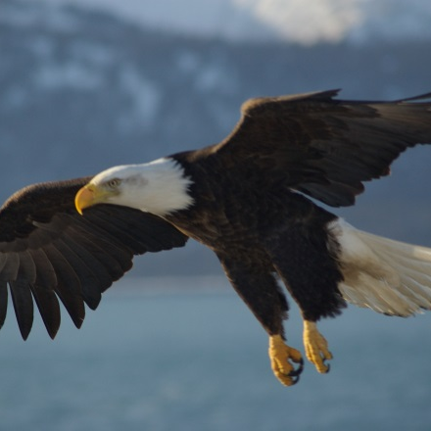
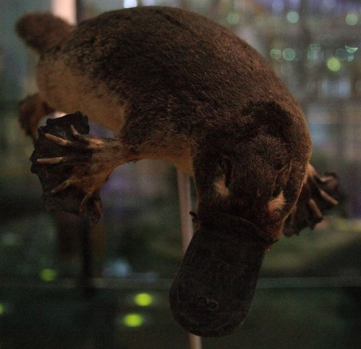
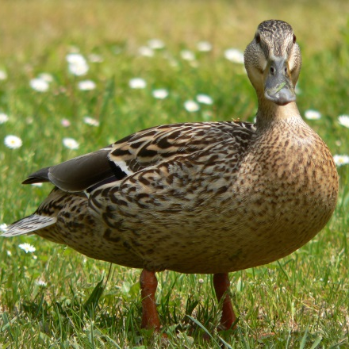
Which of these are birds?
□
□
□
□
□
□
□
□
Notes:
Image credits:
Carl Chapman, http://www.flickr.com/photos/12138336@N02/1997128094/
Elaine Wilson, http://www.naturespicsonline.com/Nature15/
Nicor, https://commons.wikimedia.org/wiki/User:Nicor
Samuel Blanc, http://www.sblanc.com/
Urville Djasim, https://secure.flickr.com/photos/urville_djasim/3611889680/
Daniel Vianna, https://commons.wikimedia.org/wiki/User:Mr.Rocks
Alessandro Di Grazia, http://www.petsugargliders.eu/
Jaroslav Novák, https://commons.wikimedia.org/wiki/File:Duck_Hen.jpg

Slide 6
...
Has wings?
Has feathers?
Has talons?
Has a beak?
Flies?
Runs?
Lays eggs?
Carnivorous?
Vegetarian?
Blue?
Red?
Swims?
Builds nests?
...

Slide 7
Cognitive System
Metacognition
Deliberation
Reasoning
Input
Output
Learning
Memory
Reaction

Slide 8
...
Has wings?
Has feathers?
Has talons?
Has a beak?
Flies?
Runs?
Lays eggs?
Carnivorous?
Vegetarian?
...
→
2^{m} actions
Cognitive System
Input
Output

Slide 9
2^{n} percepts
→
2^{m} actions
Cognitive System
Input
Output

Slide 10
10 percepts = 1024 combinations
100 percepts = 1.2 × 10³⁰ combinations
= 1.2 nonillion combinations
300 percepts = 2.0 × 10⁹⁰ combinations
= more combinations than atoms in the universe
Cognitive System
Input
Output

Slide 11
2^{n} percepts
→
2^{m} actions
Cognitive System
Input
Output

Slide 12
2^{n} percepts
→ k concepts →
2^{m} actions
Cognitive System
Input
Output

Slide 13
2^{n} percepts
→ k concepts →
2^{m} actions
“Equivalence Classes”
Cognitive System
Input
Output

Slide 14
For each of these three animals, choose the value for each percept that applies to that animal.
Eagle | Bluebird | Penguin
Lays eggs? ο Yes ο No ο Maybe Has wings? ο Yes ο No ο Maybe Has talons? ο Yes ο No ο Maybe Flies? ο Yes ο No ο Maybe Has fur? ο Yes ο No ο Maybe Large? ο Yes ο No ο Maybe | Lays eggs? ο Yes ο No ο Maybe Has wings? ο Yes ο No ο Maybe Has talons? ο Yes ο No ο Maybe Flies? ο Yes ο No ο Maybe Has fur? ο Yes ο No ο Maybe Large? ο Yes ο No ο Maybe | Lays eggs? ο Yes ο No ο Maybe Has wings? ο Yes ο No ο Maybe Has talons? ο Yes ο No ο Maybe Flies? ο Yes ο No ο Maybe Has fur? ο Yes ο No ο Maybe Large? ο Yes ο No ο Maybe

Slide 15
Block
is-a
is-a
Brick
Wedge

Slide 16
Vertebrate
Reptile
Bird
Mammal
Eagle
Bluebird
Penguin

Slide 17
How would you characterize the class ‘bird’ given the characterization of its subclasses below?
 | Bird
Lays eggs? ο Yes ο No ο Maybe Has wings? ο Yes ο No ο Maybe | Has talons? ο Yes ο No ο Maybe Flies? ο Yes ο No ο Maybe | Has fur? ο Yes ο No ο Maybe Large? ο Yes ο No ο Maybe
Eagle | Bluebird | Penguin
Lays eggs? Yes Has wings? Yes Has talons? Yes Flies? Yes Has fur? No Large? Yes | Lays eggs? Yes Has wings? Yes Has talons? Yes Flies? Yes Has fur? No Large? No | Lays eggs? Yes Has wings? Yes Has talons? No Flies? No Has fur? No Large? Yes

Slide 18
More formal
Axiomatic concepts
Prototype concepts
Exemplar concepts
Less formal

Slide 19
Axiomatic concepts:
Concepts defined by a formal set of necessary and sufficient conditions.
Example: a circle

Slide 20
Axiomatic concepts:
Concepts defined by a formal set of necessary and sufficient conditions.
Circle: all points in a plane that are equidistant from a single point.

Slide 21
Prototype concepts:
Base concepts defined by a typical example with overridable properties.
Example: a chair

Slide 22
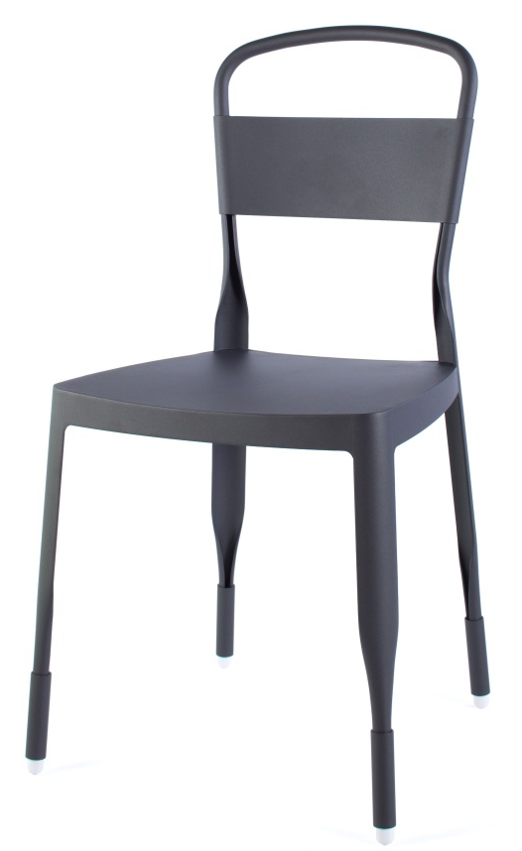
Prototype concepts:
Base concepts defined by a typical example with overridable properties.
Chair
#-of-legs : four material : metal
has-back : true
has-arms : false
is-cushioned : false
...

Slide 23
Prototype concepts:
Base concepts defined by a typical example with overridable properties.
Chair
#-of-legs : four
material : metal
has-back : true
has-arms : false
is-cushioned : false
...
Stool
has-back : false
...
Folding chair
has-back : true
#-of-legs : four
has-arms : false
...

Slide 24
Exemplar concepts:
Concepts defined by implicit abstractions of instances, or exemplars, of the concept.
Example: beauty

Slide 25
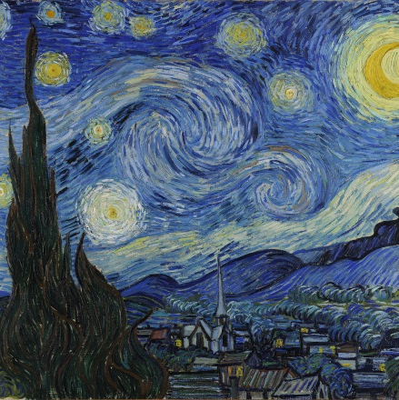

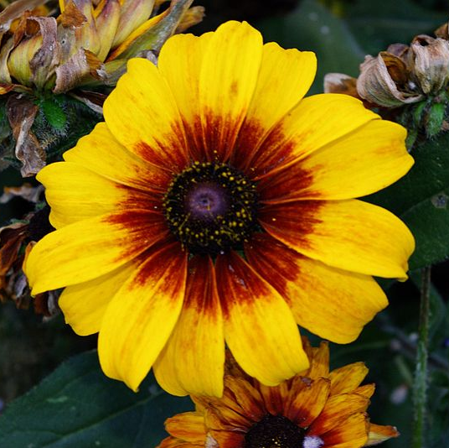
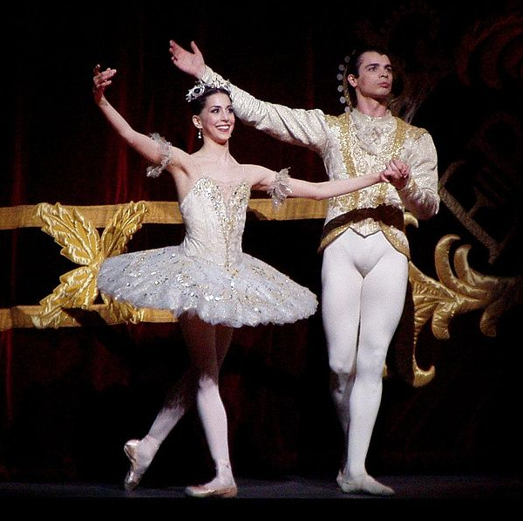
Exemplar concepts:
Concepts defined by implicit abstractions of instances, or exemplars, of the concept.
Notes:
Image credit:
DNGDesign, http://dngdesign.deviantart.com/art/Sunset-361106086
scillystuff, http://www.flickr.com/people/55296256@N00

Slide 26
More formal
Axiomatic concepts
Prototype concepts
Exemplar concepts
Less formal

Slide 27
More formal
Rank the following concepts based on their formality:
Inspirational
Reptile
Foo
Right Triangle
Holiday
Saltiness
4. Right Triangle
2. Reptile
3. Foo
5. Holiday
1. Inspirational
6. Saltiness
Less formal

Slide 28
Vertebrate
Reptile
Bird
Mammal
Eagle
Bluebird
Penguin

Slide 29
Future of
Dow Jones
Industrial
Average
GDP
Inflation
Employment
Overtime
Hours
New
Orders
Index
Jobless
Claims
Commodity
Futures
Index
GDP
3/4ths
Age
Job
Vacancies
Consumer
Sentiment
Index
NASM
ISM
PMI
Actual
Hours
Worked

Slide 30
Assignment
How would you use classification to design an agent that could answer Raven’s progressive matrices?

Slide 31
To recap…
Concept learning
Equivalence classes
Concept hierarchies
Axiomatic, prototypical, and exemplar concepts
Bottom-up search

